Slide 1
Assisting Assembly Workers by Detecting Moving Objects
Muhammad Al-Amin

Slide 2
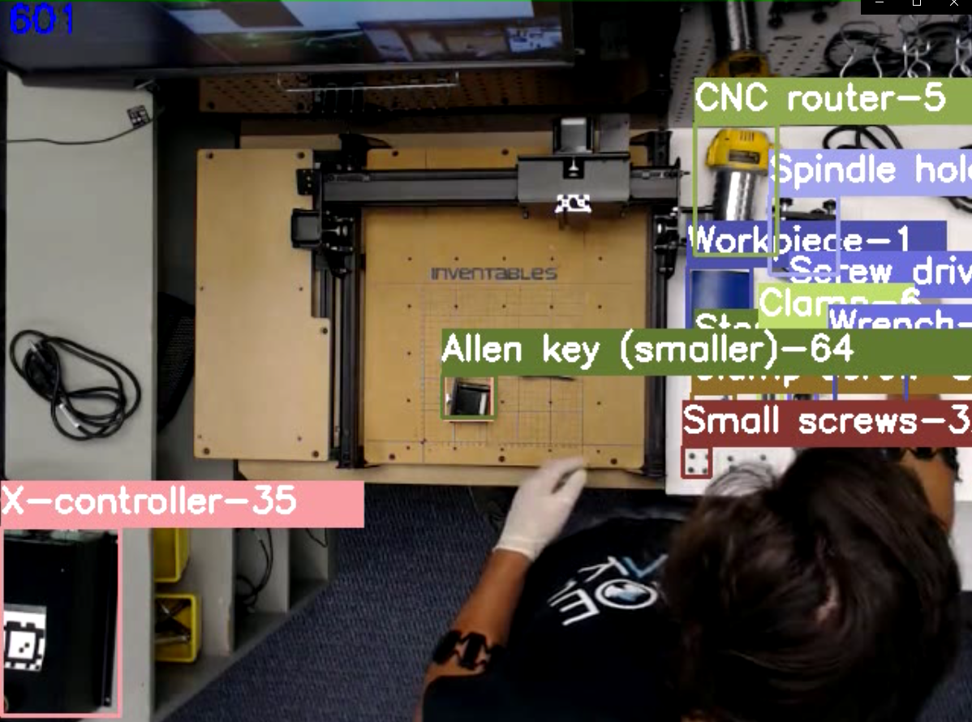
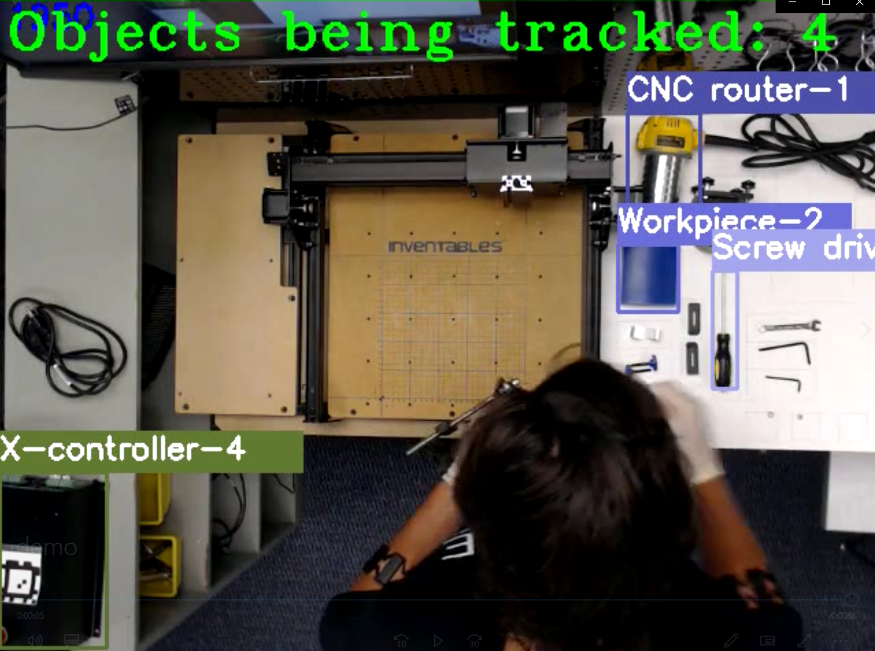
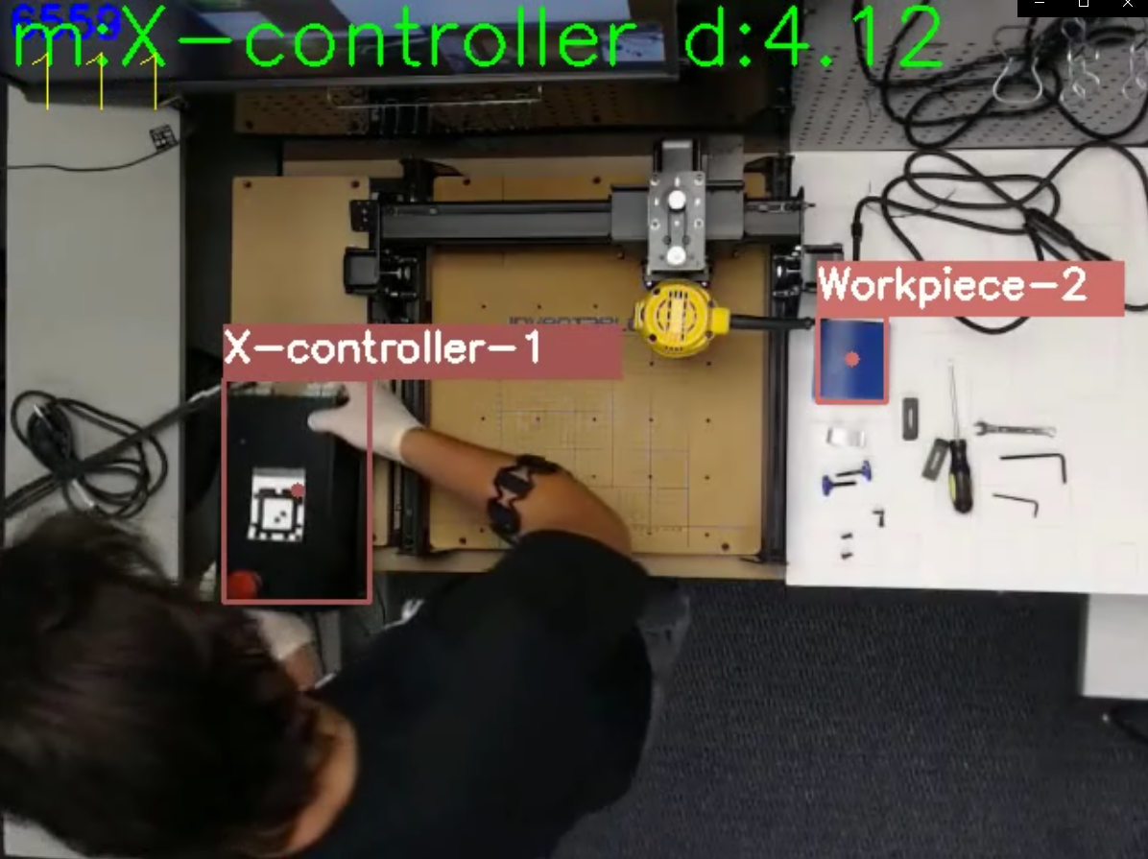
Workflow
Object detection: YOLOv4
Object tracking: Deep SORT
Moving object: Proposed algorithm
What objects worker are using in each step
Provide feedback if worker using wrong tool/part

Slide 3
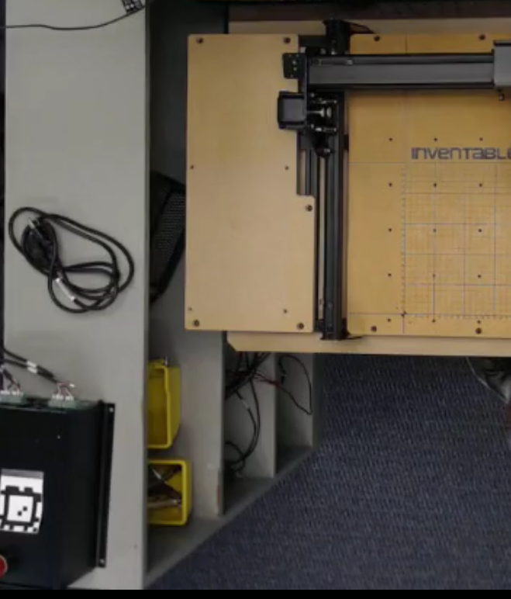
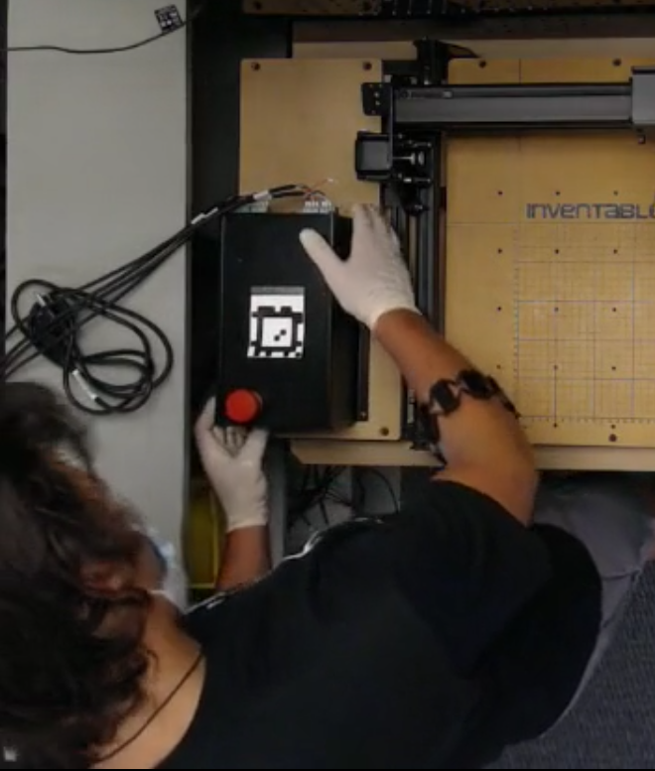

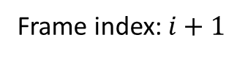
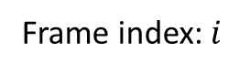

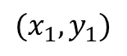
Method: #1 (frame to frame)
Measure Euclidean distance of detected objects over successive frames
X-controller
Center coordinate
$$(x_{2},y_{2})$$
X-controller
Center coordinate
$$(x_{1},y_{1})$$
Frame index: $i$
Frame index: $i+1$
$$Displacement of X−controller,D_{(i,i+1)}^{X−con.}=\sqrt{{(x_{1−}x_{2})}^{2}+{(y_{1−}y_{2})}^{2}}$$

Slide 4
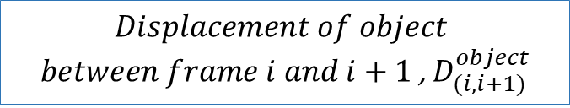
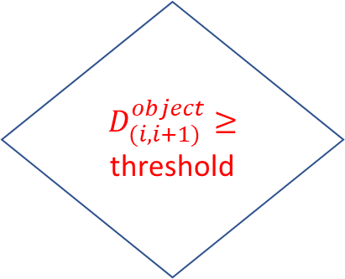
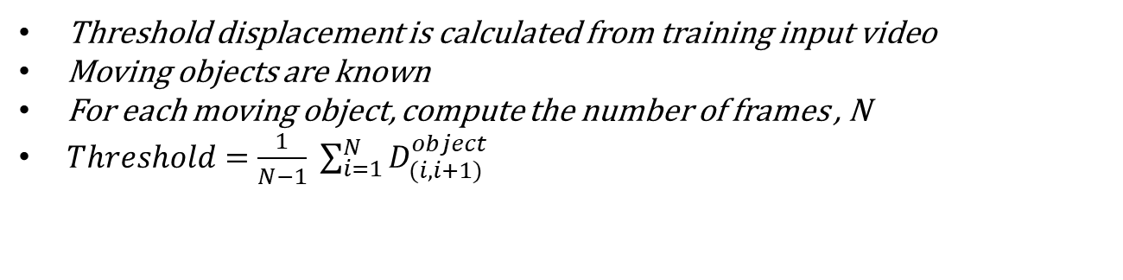
Movement Detection Algorithm
Yes
Movement detected
Testing:
$D_{(i,i+1)}^{object}≥$ threshold
$$Displacement of object$$
$between frame i and i+1$, $D_{(i,i+1)}^{object}$
No
Movement not detected
Training:
Threshold displacement is calculated from training input video
Moving objects are known
For each moving object, compute the number of frames , N
$Threshold=\frac{1}{N−1} \sum_{i=1}^{N}{D_{(i,i+1)}^{object}}$

Slide 5


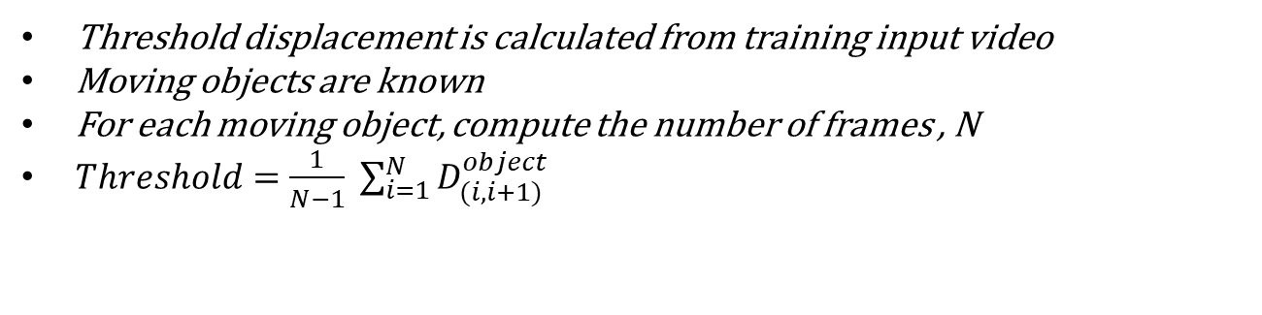
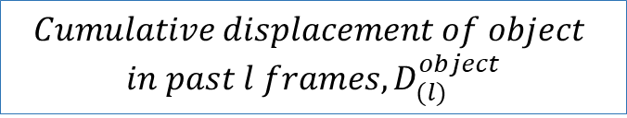
Method: #2 (Temporal window)
Cumulative sum of Euclidean distances of detected objects over past few frames
Temporal window length, $l$ determines the number of past frames
For instance, $l=2$ means past 2 frames are considered
Yes
Movement detected
Testing:
$D_{(l)}^{object}≥$ threshold* $l$
$$Cumulative displacement of object$$
$$in past l frames,D_{(l)}^{object}$$
No
Movement not detected
Training:
Threshold displacement is calculated from training input video
Moving objects are known
For each moving object, compute the number of frames , N
$Threshold=\frac{1}{N−1} \sum_{i=1}^{N}{D_{(i,i+1)}^{object}}$

Slide 6
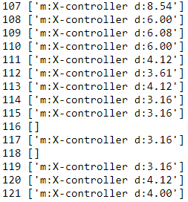
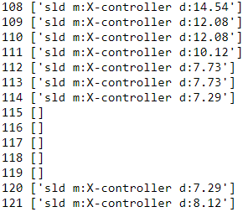
Temporal Window (2 frames)
Comparison between two methods
Frame to frame
Threshold distance= 3
Threshold distance= 3*2 =6

Slide 7
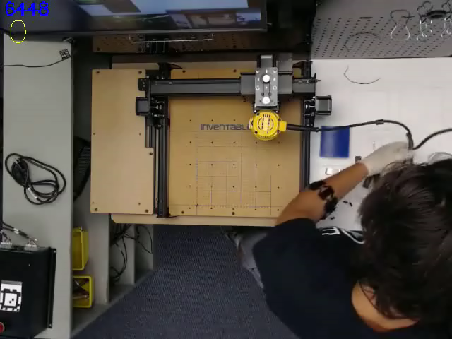
Sliding Window (2 frames)
Frame to frame displacement

